Slide 1

Human resources analysis
AdventureWorks Executive Leadership
Marina Mikhailova/Data Analyst

Slide 2
Tasks for the analysis
How is our company’s headcount growing and what is the attrition rate
Do we pay gender-equally
Do we need to fill in any position

Slide 3
Company’s headcount growth

Slide 4
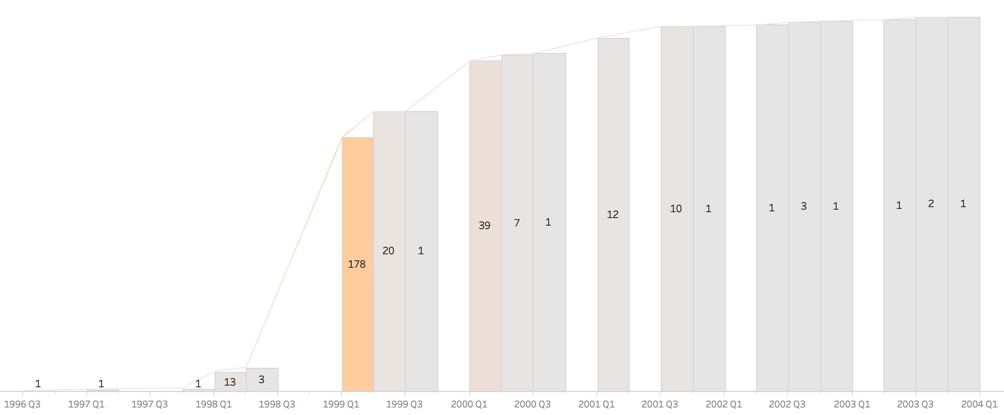
Headcount over time
We’re now at 290 employees
The company’s major headcount growth
Company’s work starts

Slide 5
Main KPIs
Number of Employees – 290
Departments – 16
Cities – 31
Average Age – 36
Attrition – 2.1%

Slide 6
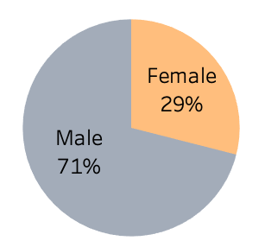
Gender Ratio
By 2004:
Men – 206
Women – 84
We’ve got more male over female employees in our technical departments

Slide 7
ATtRition
Attrition is 2.1%
(in 8 years)
With 3 men and 3 women leaving the company

Slide 8
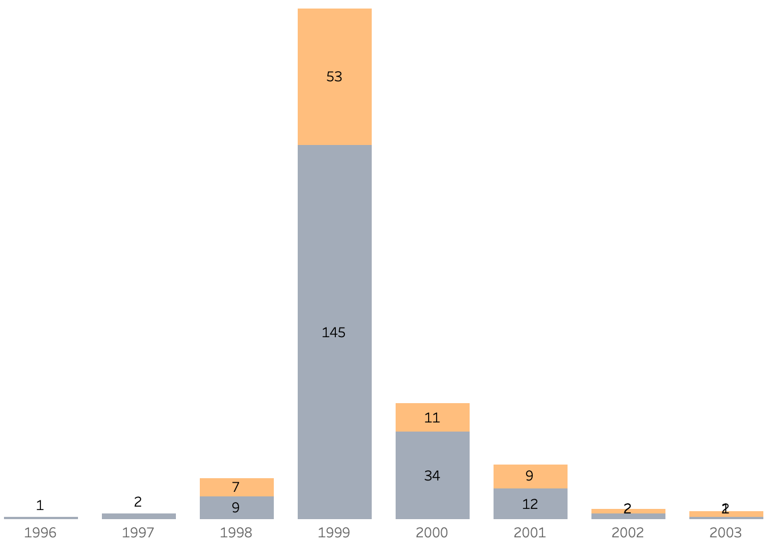
Hires Over time
The peak year of expanding our staff – 1999
with majority of hires in Production –
104 men and 34 women

Slide 9
Hires Over time
The peak year of expanding our staff – 1999
For future analysis:
To check if the company’s decrease in staff expansion is the marker of overall business stagnation (match with sales analysis)

Slide 10
Age groups

Slide 11
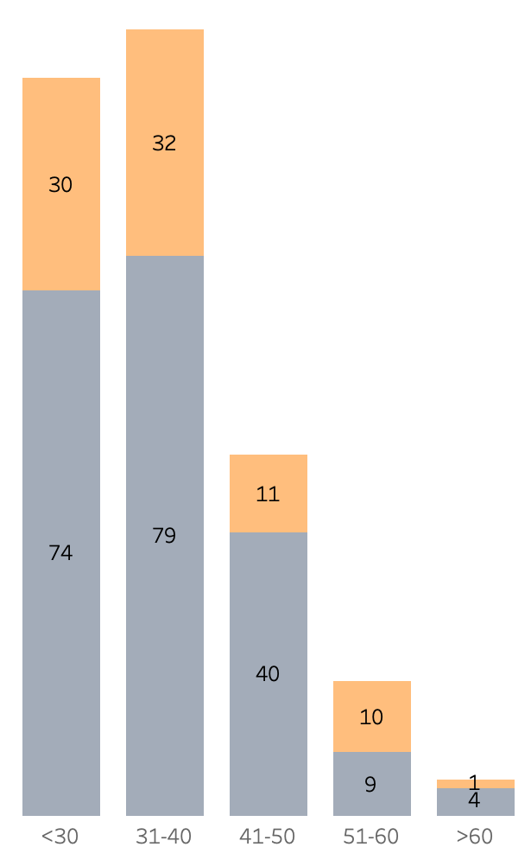
Age groups
We divide our headcount into 5 groups
The two major age groups are <30 and 31-40 that together make 74% of our headcount

Slide 12
Rates and gender

Slide 13
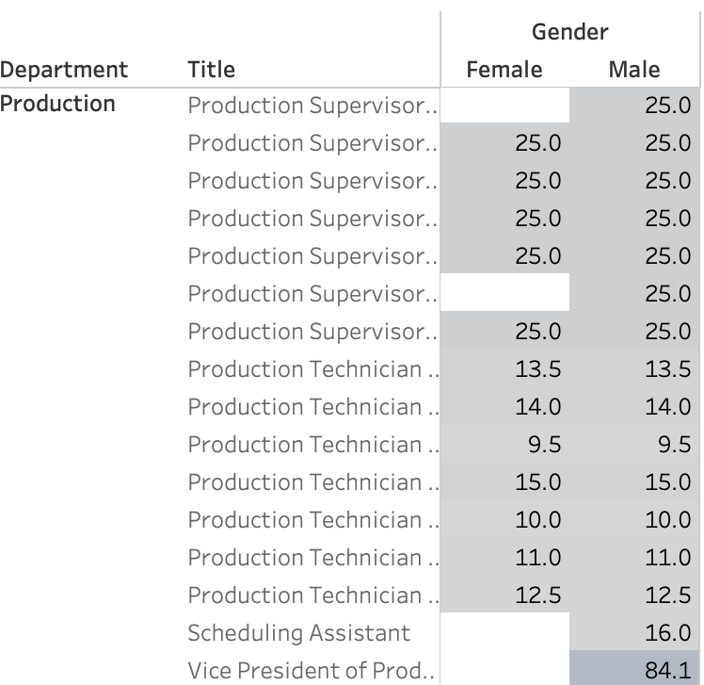
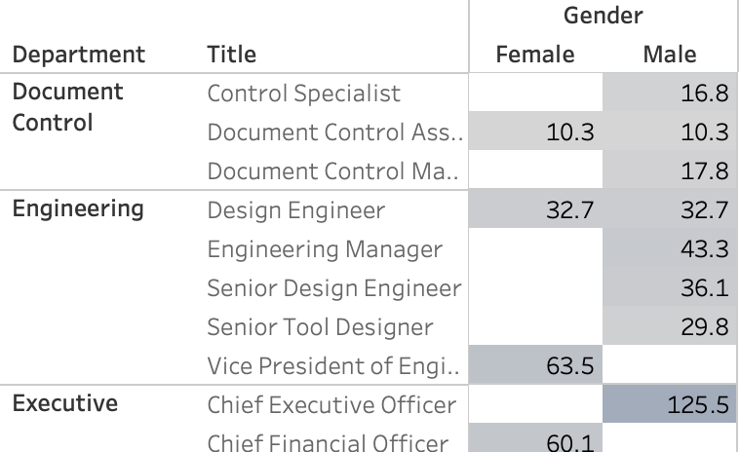
Pay Rates and GEnder
Rate pay per hour ($)
We can see that people are paid equal rates, no matter their gender
This is shown in all of our departments
Rate pay per hour ($)

Slide 14
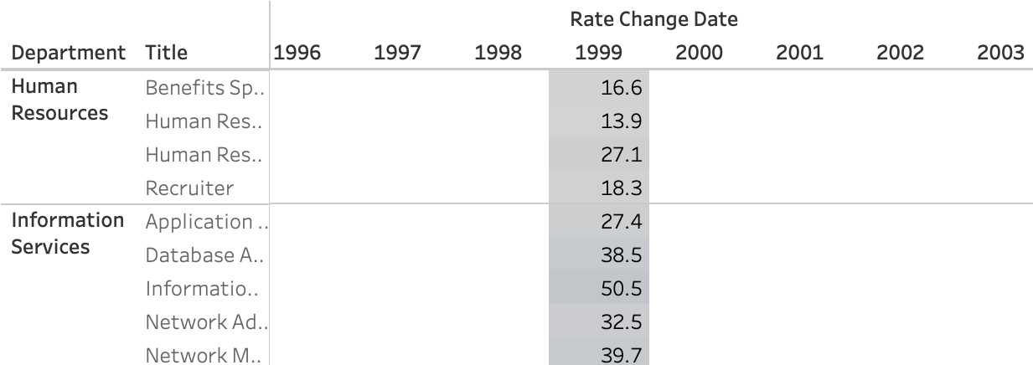
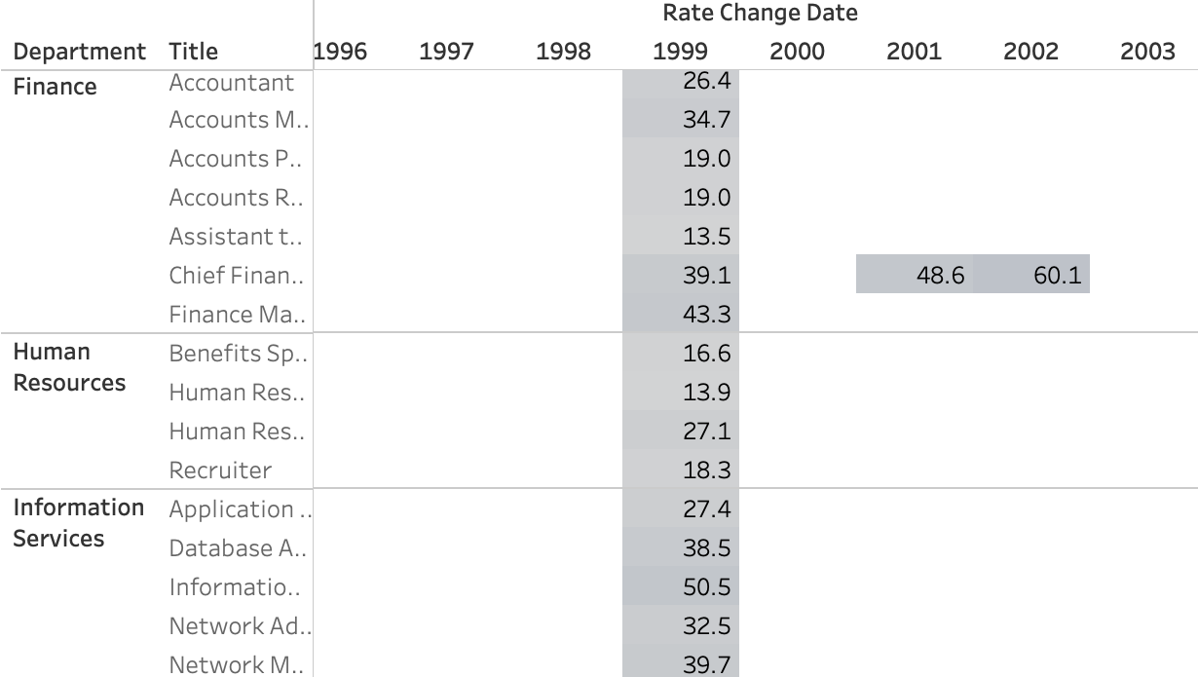
Pay Rates change
However, for some positions the last rate change was over 4 years ago, that is something to analyze in the future
Rate pay per hour ($)
Rate pay per hour ($)

Slide 15
Possible new positions

Slide 16
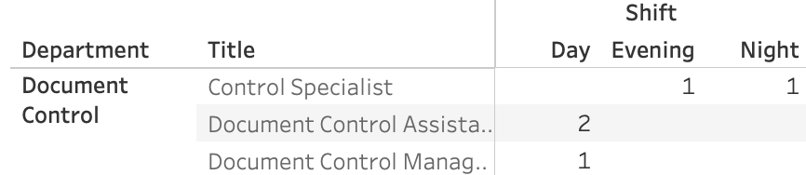
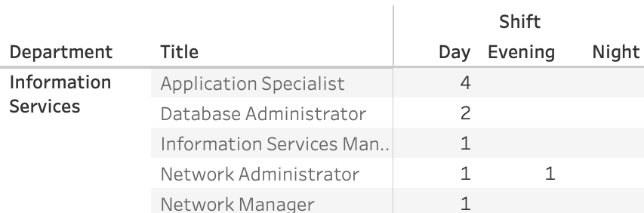
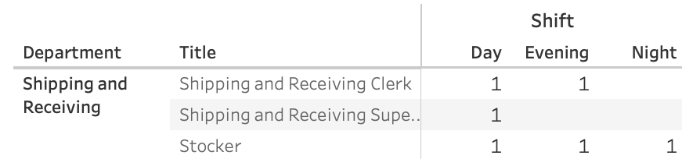
Possibility of new hires
Recommendation would be:
To consider hiring additional employees for the shifts that are not covered by current staff

Slide 17
To conclude
Our company has steady staff of 290 employees with attrition of 6 people in 8 years
Where 2/3 of our headcount is male and 1/3 - female employees
With 74% of our headcount in the age below 40
We keep rate pay equal to both gender employees

